Slide 1

Practical Python For Modeling
J.D. Landgrebe
Data Delve LLC
version July 12, 2023

Slide 2



Workshop Leader Background: J.D. Landgrebe
34 years as Procter and Gamble R&D technologist
Material supply, consumer understanding, IP, R&D
Global Modeling Community
Training and mentoring
Chemical Engineering BS and MS
Aerosol Science Research and Publications – Particle Size Growth Modeling
Data science and technical modeling
Excel/VBA, JMP and Python software
Visualization, and design of experiments
PowerBI/DAX
Consulting Practice: datadelveengineer.com
LinkedIn www.linkedin.com/in/jdlandgrebe

Slide 3
Motivations/Insights– Do these Resonate?
Good collaboration on models depends on contributors having space within which to work and confidence in how to connect their work with others’
The right amount of code planning cuts down on rework and allows you to work with more complex topics
Picking a model back up from someone else (or from the one-year-ago you) can be challenging
Most models don’t have an inspectable validation trail that that builds confidence in them as you work with them and seek to extend them

Slide 4

Characteristics of Good Models and Analysis Pipelines
Good models and analyses are curated. Another knowledgeable human can look at the files and not only repeat the analysis but extend it without the author being present.
Good models and analyses are validated. They come with re-runnable test cases consisting of mocked up data proving correctness of calculations, data cleaning steps and output generation.
Good models are maintainable and extensible. They are written in a modular way, so that they are easy to build on and easy to reapply.

Slide 5

Takeaways For You From these Workshops
Grow in your ability to architect your projects for personal efficiency and collaboration
Learn to distinguish Python code by a 3-level architecture quality scale
Practice creating Level 2 (aka Jupyter notebook arranging functions into ”procedures”) code for models
Learn basic elements of a Level 3 approach
Jupyter “dashboard” + *.py code structure
”Tuhdoop” combination of pre-written Pytest validation (TDD) and object-oriented programming with Python classes (OOP)
Learn folder structures and projfiles.py file management library helpful for curating and collaboration
Model connects naturally to needed data and *.py libraries
Toggle freely between test and “production” modes to encourage validation
Version control and ability to “use” a model while continuing to develop
Gain a planning template you can use to get organized

Slide 6
Nomenclature - Practical Definitions
Curating code and projects
Others and the future you can instantly know how a model works and how to dig deeper to get more info
The “new hire” test
Benchmark: no meeting needed with model owner/developer to get going with using and extending a model
Object-Oriented Programming (OOP) (Wikipedia)
Self-contained Python class for each topic
Classes can be divided and worked on in separate files (and work divided among multiple collaborators)
Class __init__ function instances the class and documents the attributes (aka variables) for the work
Single-action class functions (aka “methods”) do the work
Jupyter procedural cells or class @property functions instance the classes and call functions to do the model’s work
Test-Driven Development (TDD) (Wikipedia)
Use Pytest and test datasets to validate your code (coding consists of creating parallel test_xxx.py and xxx.py files)
Pre-write the test; Write simplest version of function that passes; Refactor to improve the code
TDD/OOP combo = “Tuhdoop” (Tutorial) Creates synergy when building models and data transformation code

Slide 7
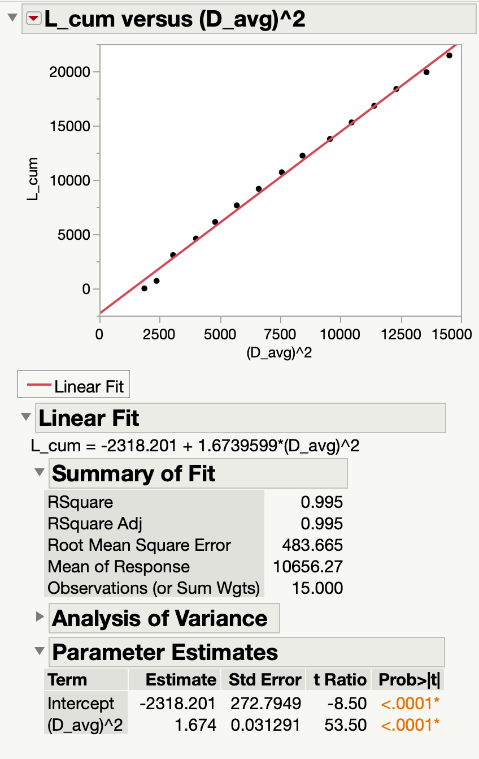
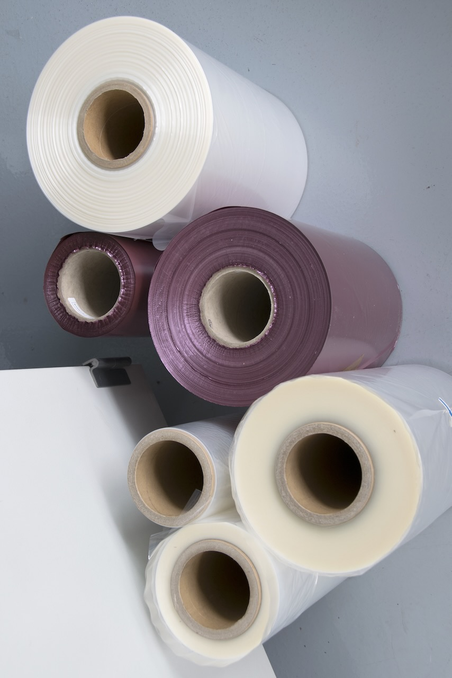
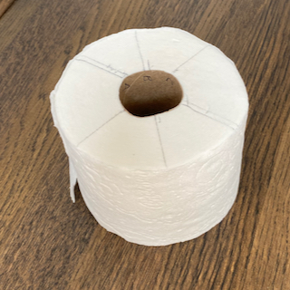
Example Model for Learning ”TuhDooP”
Model is a teaching case study in Digital Transformation with Excel Online Course
We can use its raw and transformed data for validating a Python version
Roll Length Model.xlsx - Toilet paper example
Technical model to calculate length of substrate on a roll based on diameter
Model is industrially useful in R&D and manufacturing settings
Example raw data and equation derivation available as background in file
Transformed/Linearized

Slide 8
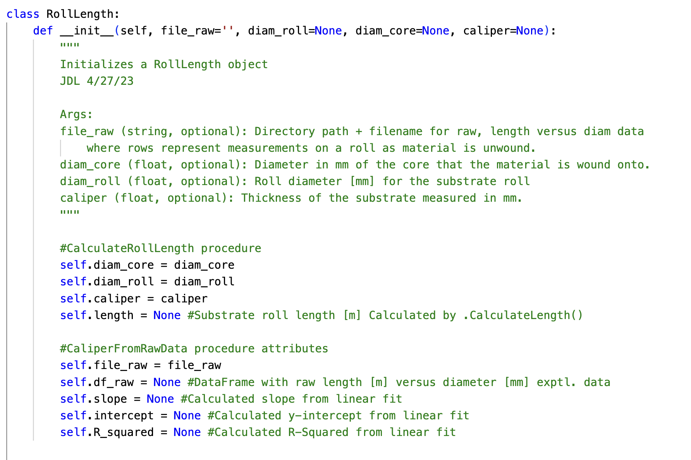
Object-Oriented Python Basics
Classes (aka objects) have an __init__ method to populate attributes that are inputs to a model or data transformation
__init__ runs whenever the class is instanced with a statement like this:
Good practice is initialize non-input attributes to None or empty string in __init__
Making some or all inputs optional is useful for using the Class for multiple use cases requiring different inputs
self is placeholder referring to current instance. Think of it as bucket carrying current values of all attribute variables (and as required prefix for calling methods)
Refer to a class attribute as self.var_name
r = RollLength(file_raw='raw_data.xlsx')

Slide 9
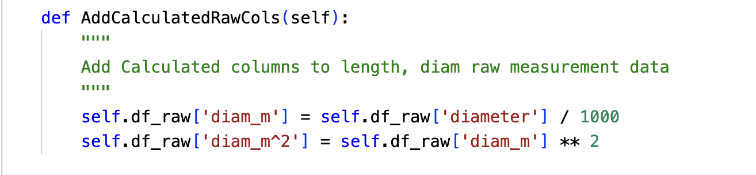
Object-Oriented Basics (Continued)
Method functions have self as an argument to bring in current values of all attributes
In the example, self.df_raw is a needed input
The method modifies self.df_raw by adding two columns
Methods can also have other arguments that are not class attributes –as needed to bring values within the method’s scope for calculations
Methods do not need to have a return statement if modifying class attributes
After the method runs, the modified df_raw will be the current value in the instance of RollLength
Example RollLength Class Method

Slide 10
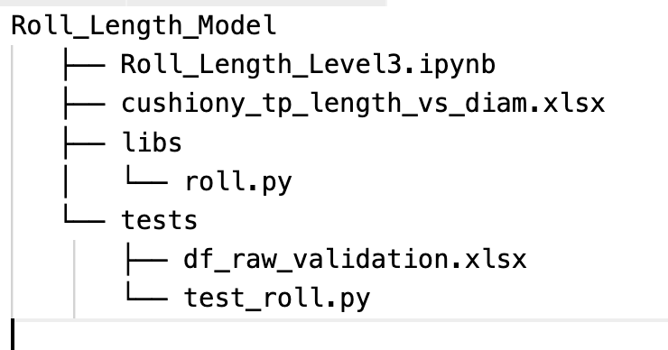
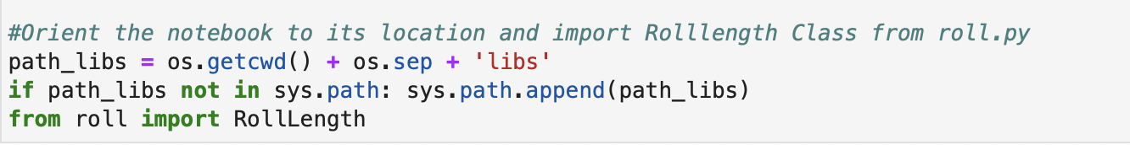
Object-Oriented Basics (Continued)
File structure for using a user-facing Jupyter Notebook
Roll_Length_Level3.ipynb
User-facing Jupyter Notebook
Input file (production)
File containing RollLength Class code
Python classes can be created in a Jupyter notebook but generally should put them in a separate *.py file
makes user-facing code cleaner / gobbledygook reduction for users
critical for giving Pytest access to code for validation
from roll import RollLength statement makes the class accessible from a Jupyter notebook (or other *.py file such as the test_xxx.py files)
The *.py file’s location needs to be added to sys.path, which is a list of locations Python will look in for importing
File with RollLength Class
Input file (for validation)
Pytest test code
sys.path addition of libs folder
and import RollLength Class

Slide 11
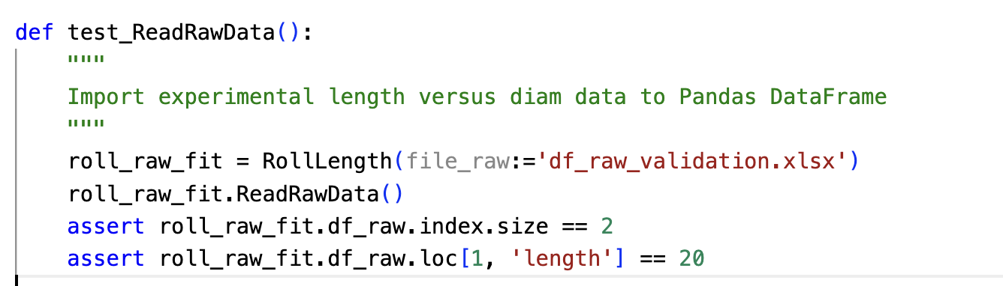
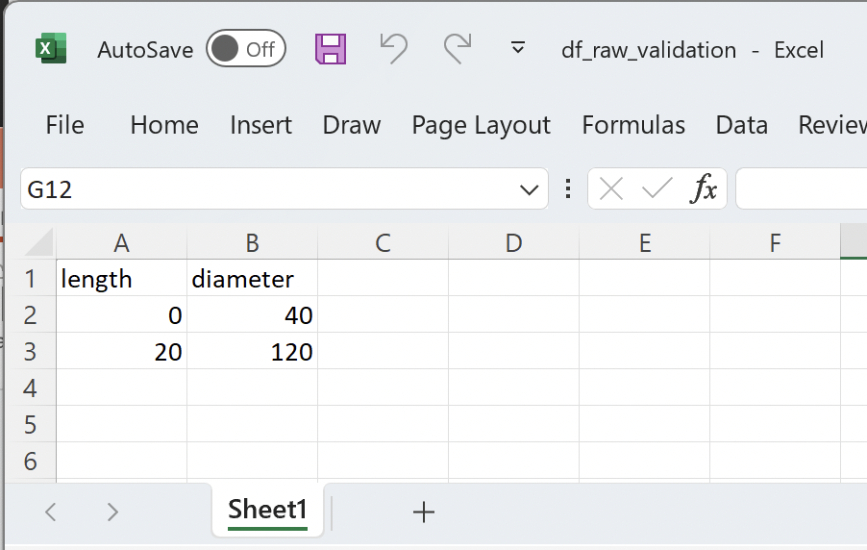
TDD / Pytest Basics
The standard Pytest library allows setting up one or more parallel test code files for validation
Run a test file with this statement (runs all test functions whose names begin with ‘test_’ prefix
Run an individual test by adding –k modifier
Pytest evaluates results based on assert statements you add. If all are True, the test passes
right side of assert needs to evaluate as True (Pass) or False (Fail)
Remember to use ”==“ for testing equality
$python –m pytest test_roll.py –v -s
$python –m pytest –v –s –k 'test_ReadRawData'

Slide 12
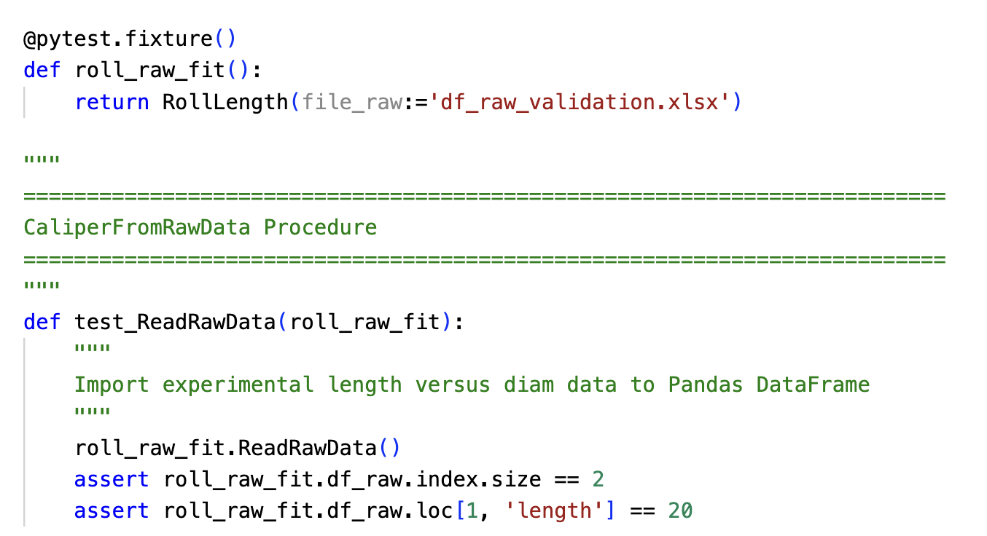
TDD / Pytest Basics (Continued)
The @pytest.fixture decorator is useful for populating items that are needed for multiple tests
The roll_raw_fit Class instance is an example
The fixture will consist of whatever is in the return statement when it is created
Include the fixture as argument in tests that need it
Fixtures are re-evaluated for each test, so it’s ok if a test modifies a fixture
Compare this version of the test with the previous slide that does not use a fixture

Slide 13
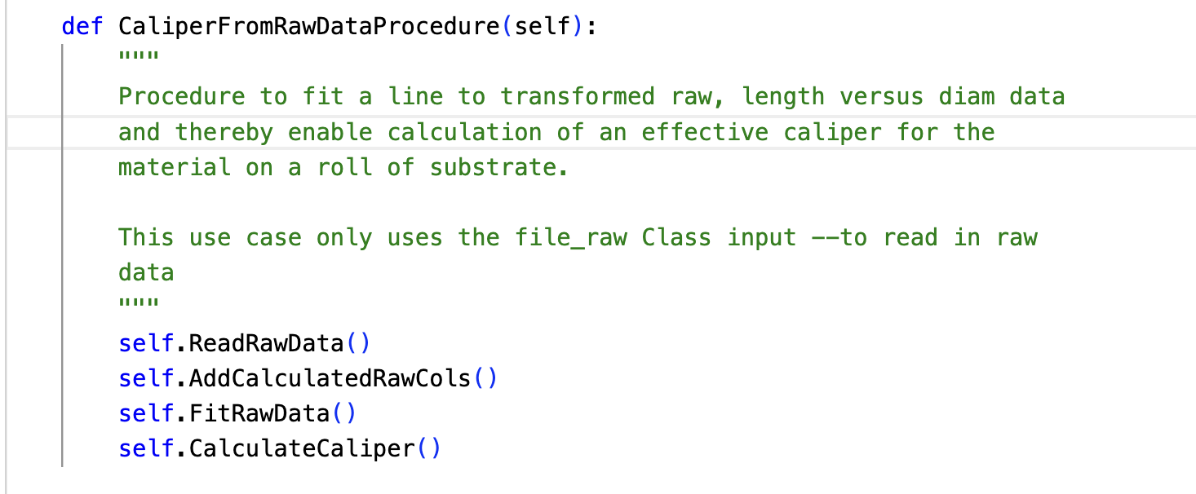
Code Architecture
In our context, architecture is the macro arrangement of application and test code (e.g. not the fine, Python style details)
Good architecture is a key for curation, validation and maintainability
For organizing architecture, it is useful to classify functions as either multi-step “procedures” or “single-action”
Single-action functions are the preferred elemental building block of coded projects
Procedures walk through a recipe of steps to complete a use case –typically by sequentially calling the single-action functions
Example procedure function that calls a recipe of four single-action functions
Example single-action function that adds two, calculated columns to the df_raw DataFrame

Slide 14
Typical Coding Styles People use for Python Models and Data Analysis
Level 1 – ad hoc “random walk” Jupyter notebook
Fast
Not well curated
Hard to validate with re-runnable checks
Hard to maintain/extend
Level 2 – Procedure/function hierarchies Jupyter
Better curation and extensibility
Better for validation but not Pytest-compatible
Level 3 – TDD/OOP aka Tuhdoop
Ideal for models that will be re-used
Conducive to re-runnable Pytest testing
Use Jupyter notebook as UI only; put most code in *.py file(s)

Slide 15
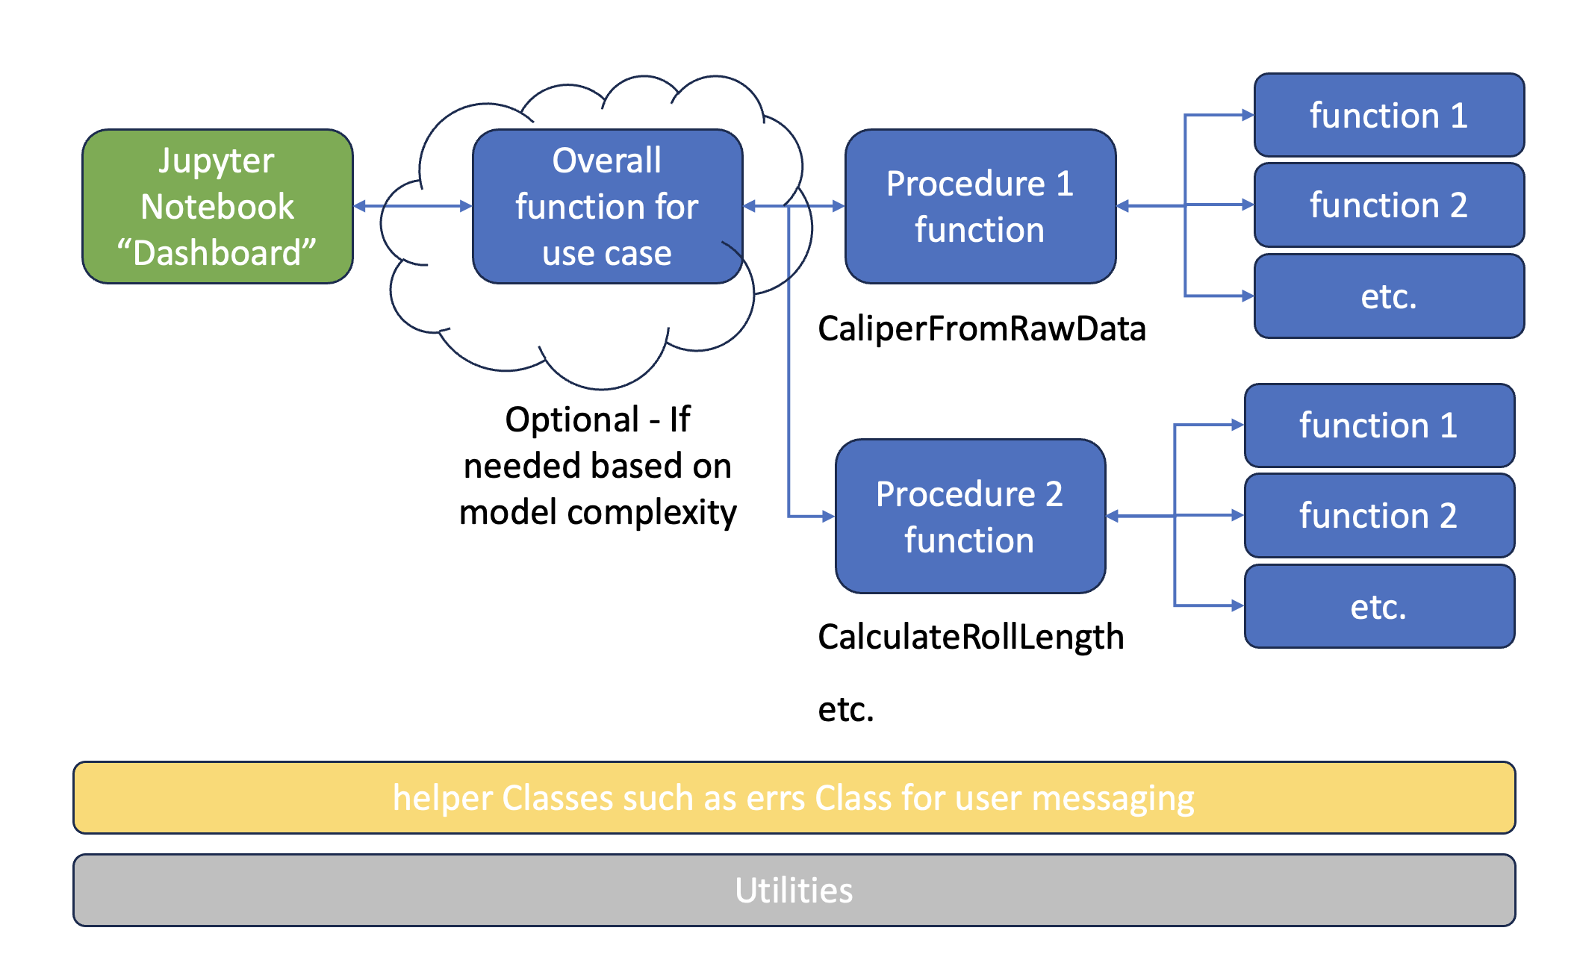
Suggested Architecture
A good, general-purpose architecture is 4-level structure
Right side blocks are single-action functions (ok to add sub-level for DRY aka avoid repetition)
Overall function allows single-line running from Jupyter
Procedure functions document the sequence needed to execute
This applies to either Level 2 or Level 3 coding styles

Slide 16
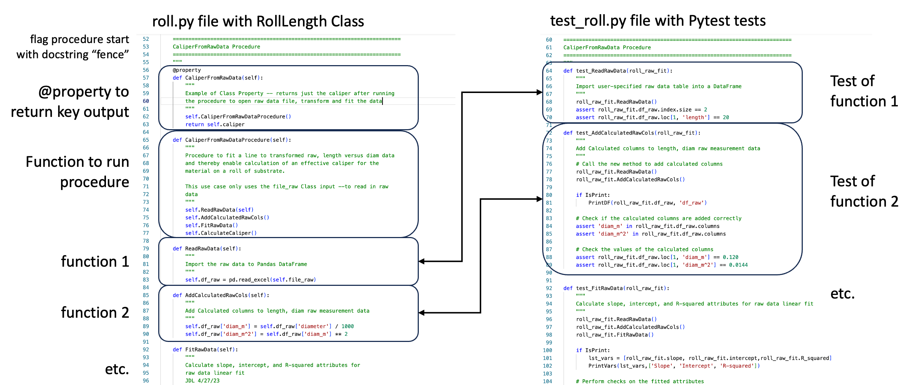
Suggested Level 3 Code Style
For curation, arrange code and tests in hierarchy corresponding to block diagram
Can be multiple tests per function but at least 1-for-1
Use @property function to return key procedure output(s) with single line statement
tests typically run/validate single-action functions but ok to include tests of procedures too

Slide 17
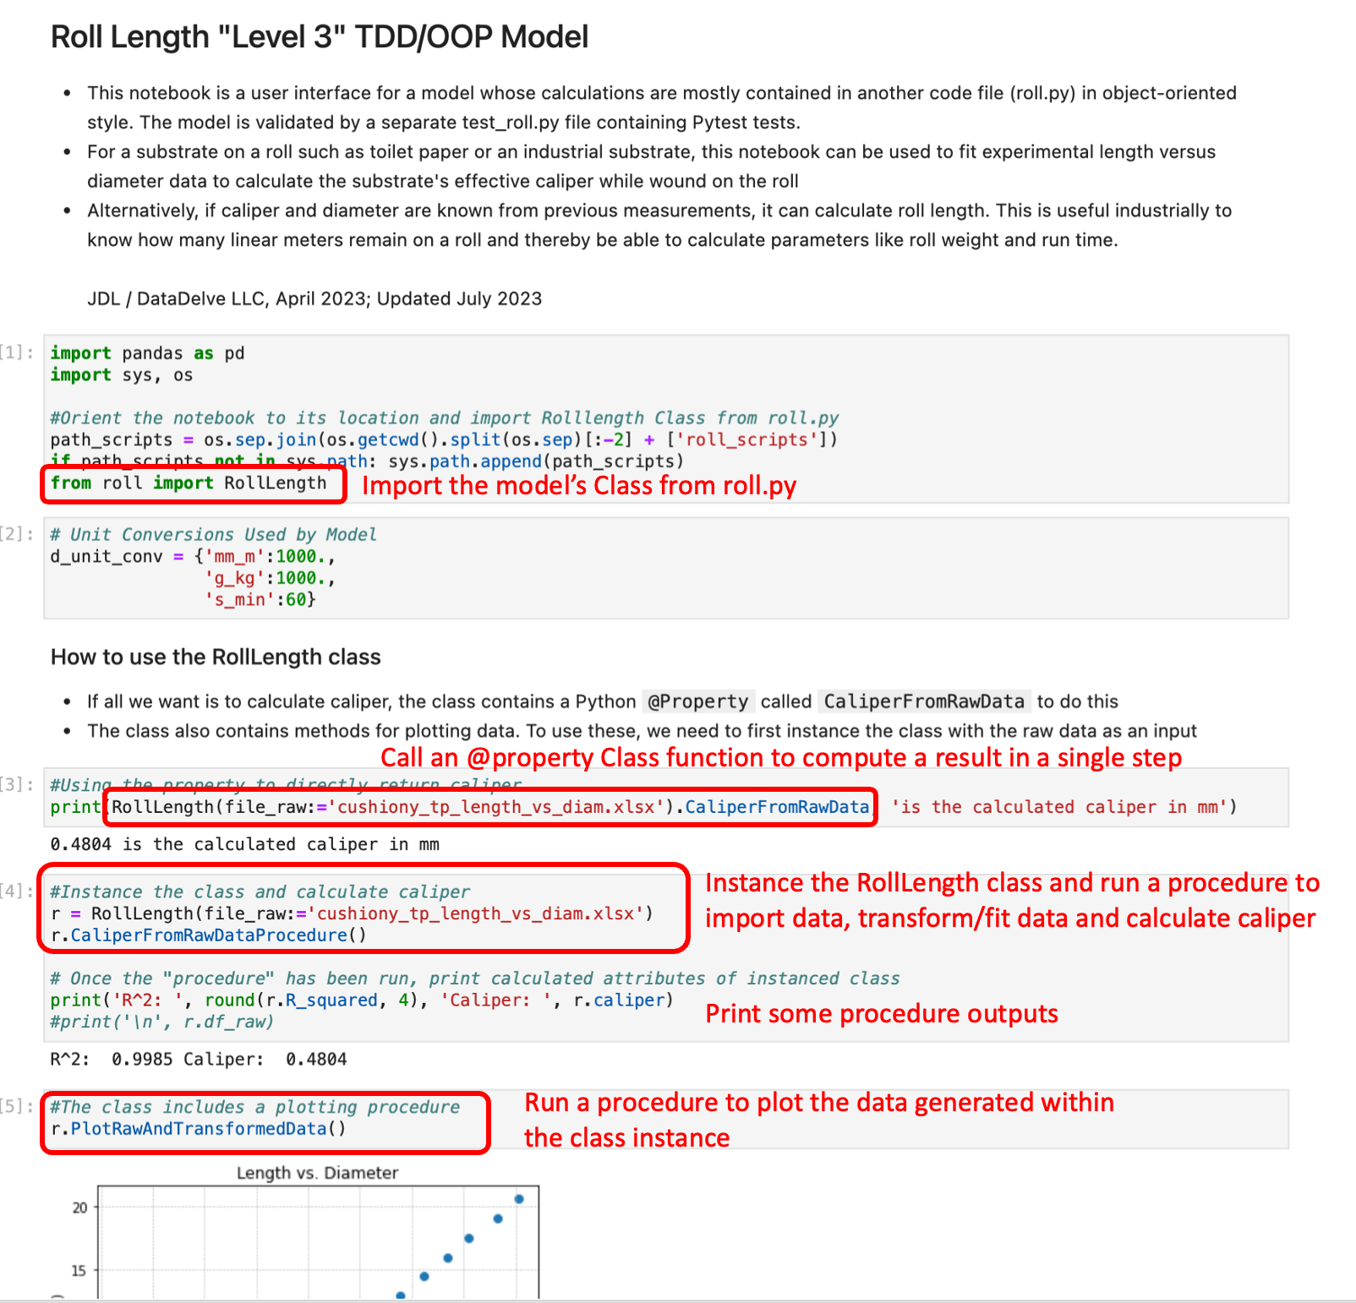
Suggested Level 3 Code Style
Use a Jupyter notebook to create a user interface dashboard for running *.py code
Procedure functions serve as wrappers for single-action functions
single-line running for @property
two-line instance + run for procedure functions

Slide 18
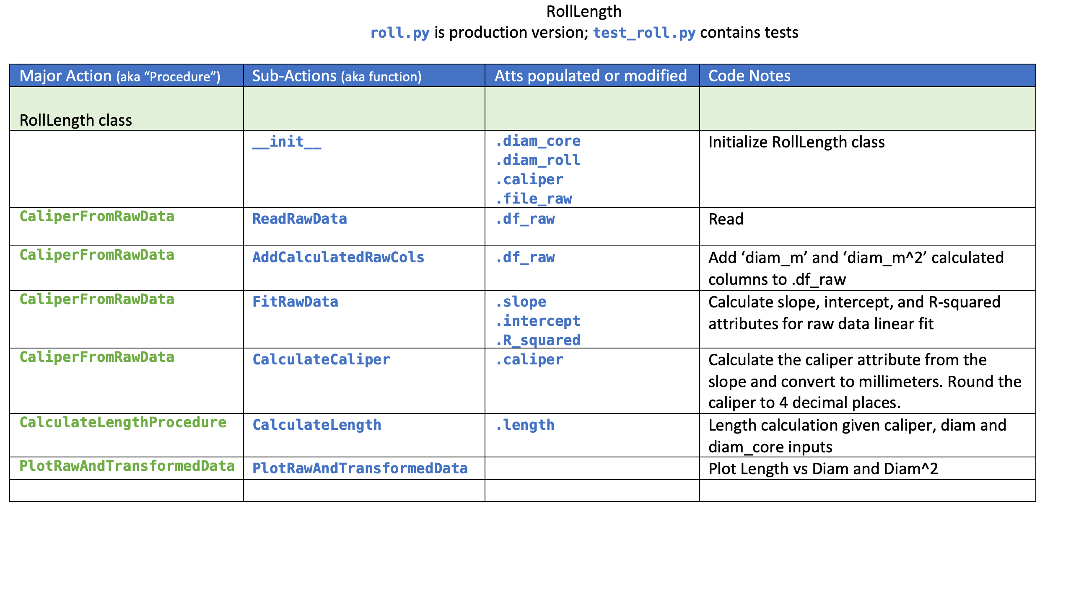
Planning Projects For Level 3
The Roll_Length_Model folder contains a Word document with a template that is useful for planning and documenting the Procedures and elemental functions for a Class

Slide 19
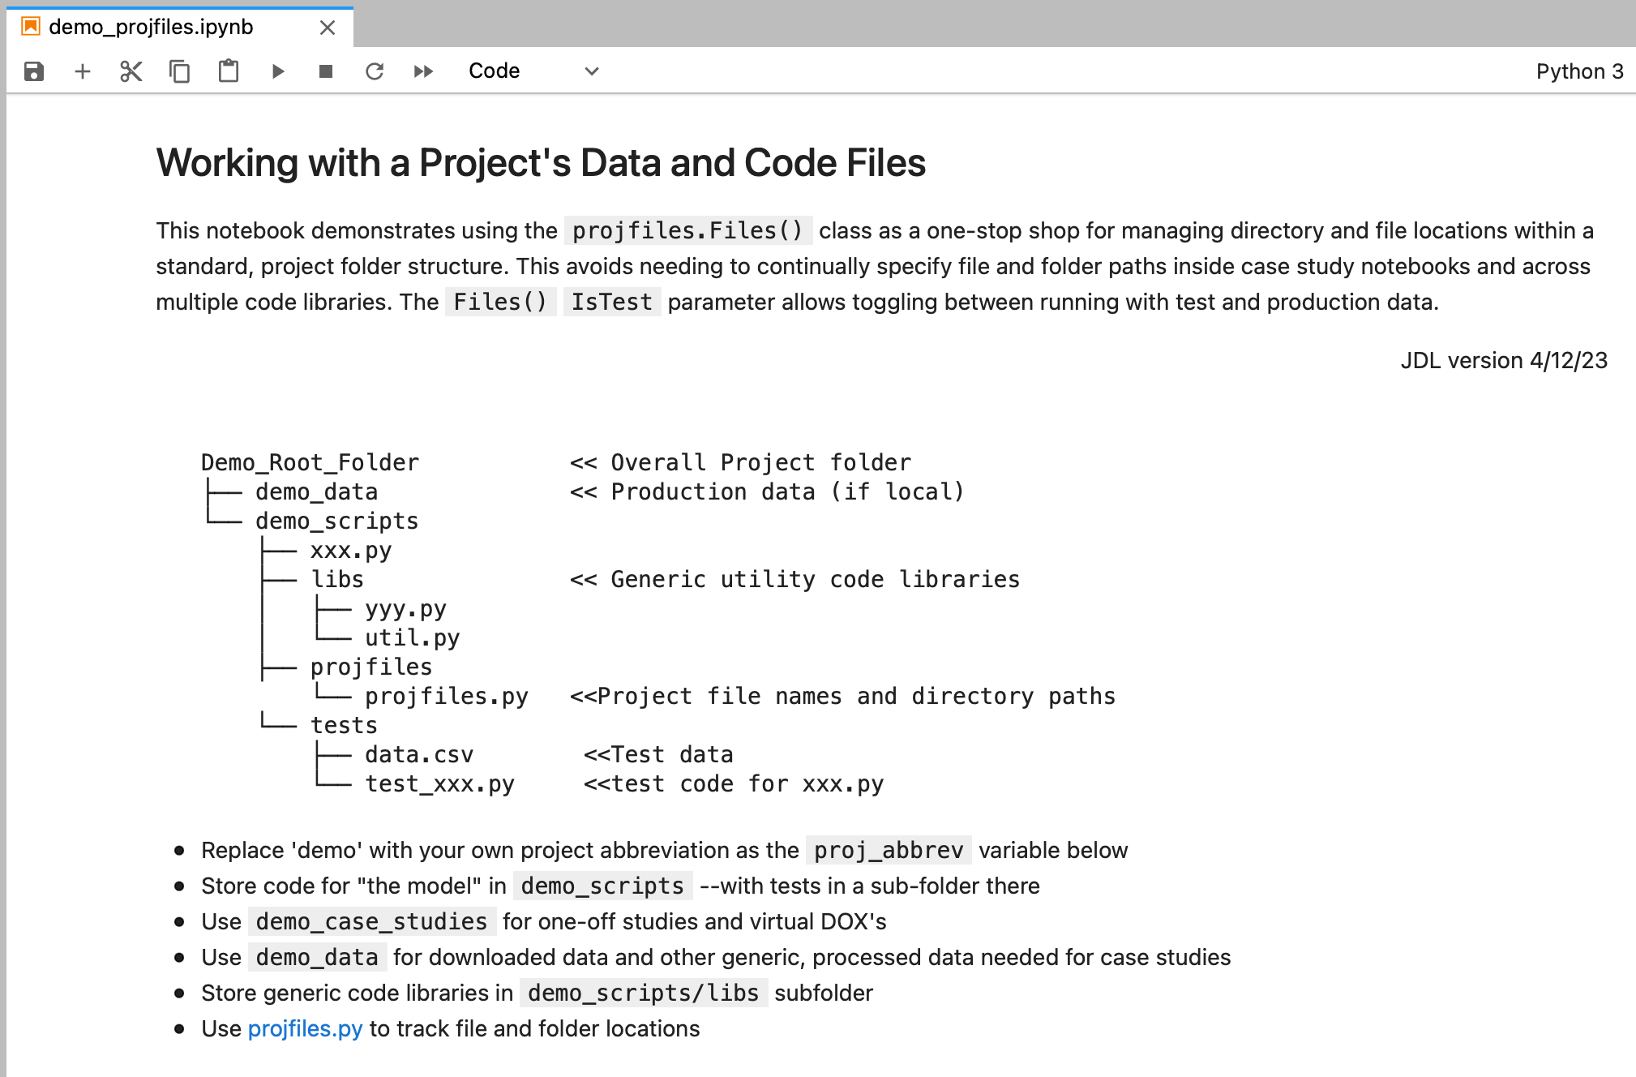
Keeping Track of A Project’s Files and Code
Previous simple folder structure good for personal model use but it’s often desirable to separate model code from “studies” and associated analysis using the model
For validation and to keep directory string gobbledygook out of users’ faces, it is helpful to set programmatic folder structure behind the scenes
Helpful to use a Boolean switch to toggle between test and production modes –making it easy to re-run validation as code changes occur
The open-source Python_Projfiles library does this by recording project folder and file locations in a class

Slide 20
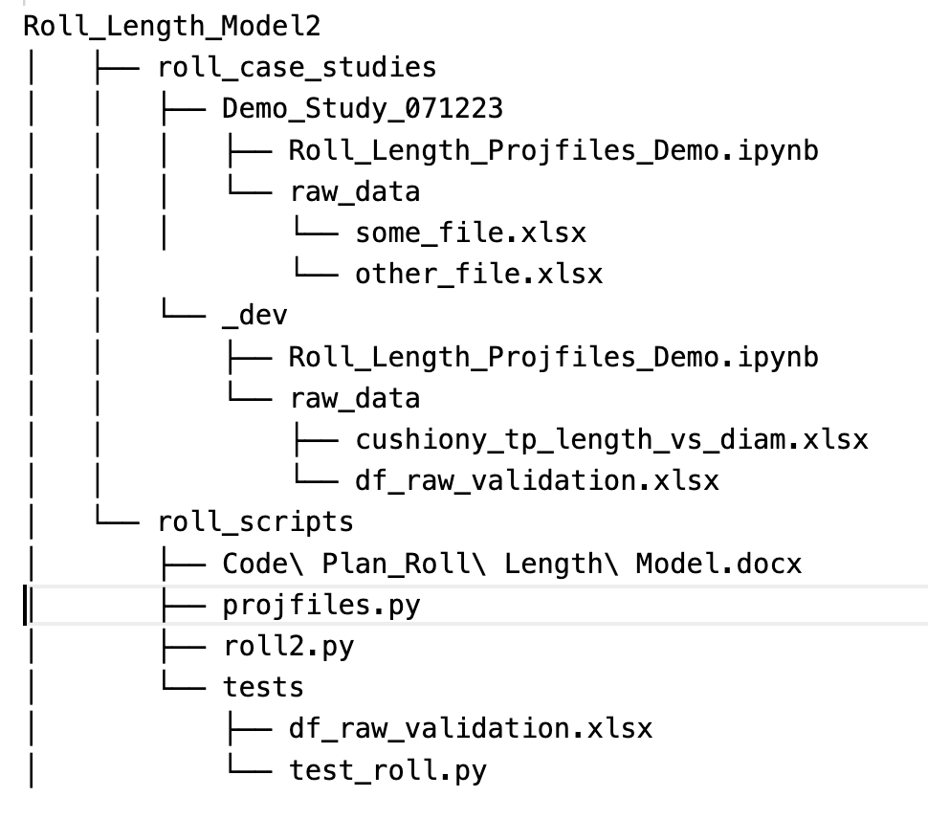
Using Python_ProjFiles
See files in Roll_Length_Model2 training folder
Projfiles helps work with a more complex project
Folder structure puts the model’s code (roll2.py here) and projfiles.py in the roll_scripts folder
roll_case_studies can contain study-specific folders instanced over time by one or more researchers
_dev folder should contain the latest Jupyter notebook with example data
users can copy and rename _dev to start working on their new modeling study

Slide 21
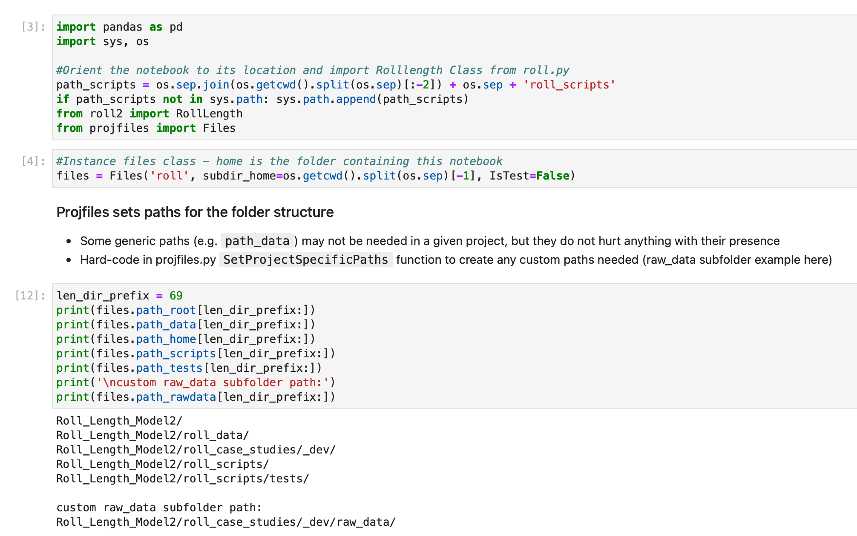
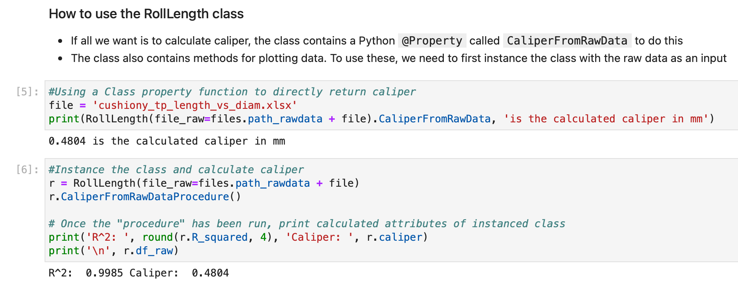
Using Python_ProjFiles (Continued
Open roll_case_studies/_dev/Roll_Length_Projfiles_Demo.ipynb
With projfiles, the Jupyter notebook imports and instanced the Files class to set all file and folder locations as attributes
Note the difference in instancing RollLength if we are directing it to a ‘raw_data’ folder whose custom path is set the files Class instance
Import Files class from projfiles.py
instance Files Class
files.path_rawdatadirects RollLength class to correct folder
demo cell:
print various files attributes including custom path to raw_data subfolder

Slide 22
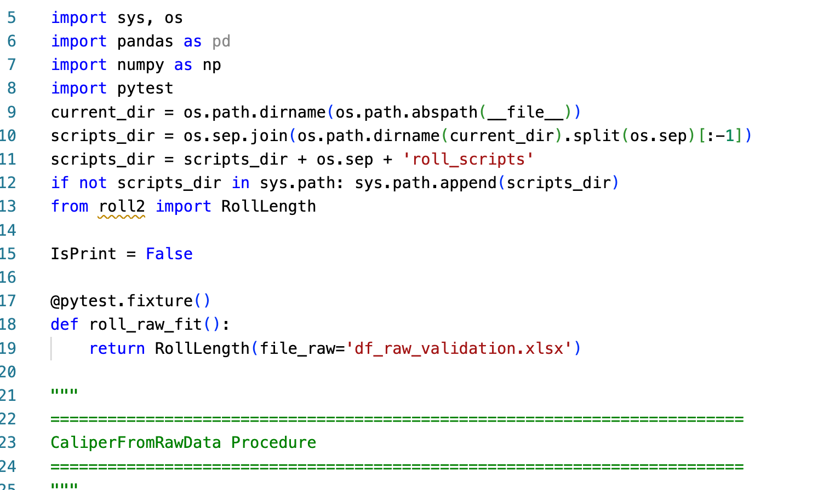
Using Python_ProjFiles (Continued
Based on the alternate folder structure, our tests file (test_roll2.py) needs to add roll_scripts to sys.path
Since we only use one data file for validation, we do not need to instance Files in test_roll2.py
If testing needs multiple data files etc., you can instance Files with IsTest=True and specify subdir_tests to point to a subfolder in tests containing validation data
If Instancing Files Class in test_xxx.py
def __init__(self, proj_abbrev, subdir_home='', IsTest=False, subdir_tests='')
Specify True for testing
Can specify tests subfolder containing validation data

